Slide 1

Welcome to our November meeting!
Why is it a good business to hire immigrants?
Jan 6, 2021

Slide 2
  Why is it a good business to hire immigrants?
  US workforce is declining and immigrants are new America’s workforce.
  Washington's immigrant population
  Benefit of hiring Immigrants.
  Immigrants require support and resources
  WIN’s Mentorship Program and Informal Networking time to help immigrants.
  Message from the WIN’s membership-video

Slide 3
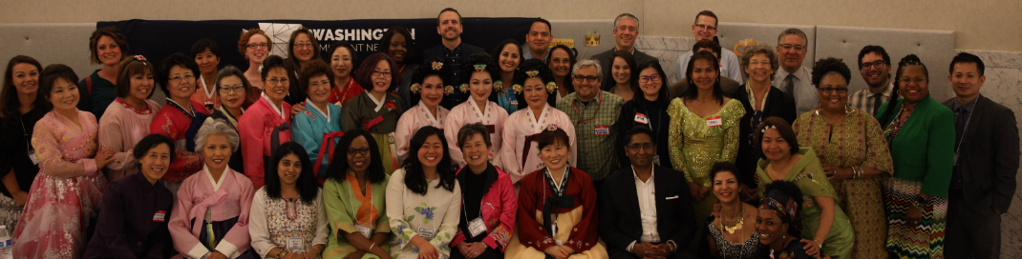
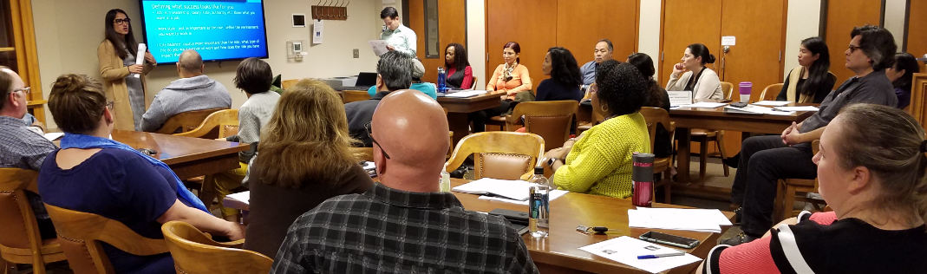
WIN -Employee driven-
Business Resource Group
  Recruitment/Retention Career Development
  Advocacy Special Events

Slide 4
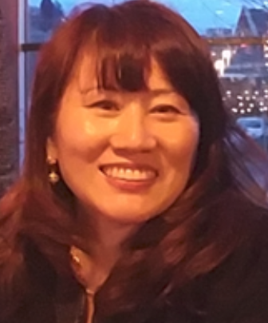


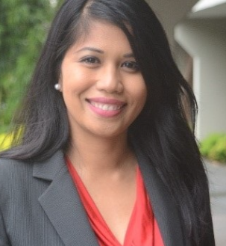
Our Presenters today:
  Kim Sauer, Chair/WSLCB
  Allison Spector, Co-Chair Career Development subcommittee/OFM
  Lolo Arevalo, Chair, Advocacy Subcommittee, DOC
  Joanne Lee, Vice-Chair/DES

Slide 5
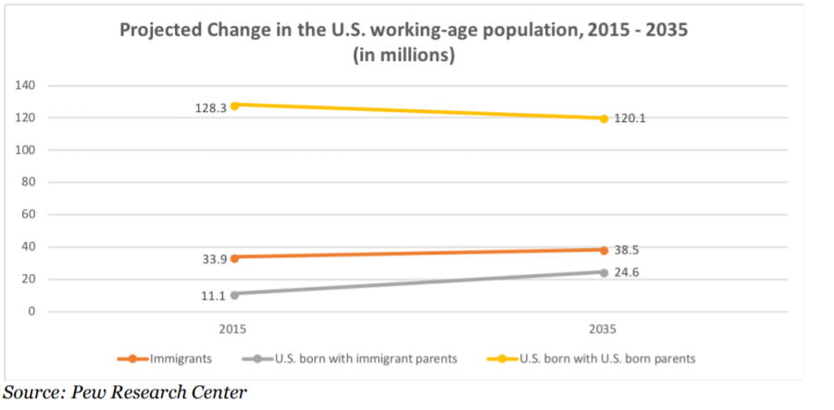
Immigrants are the New American Workforce
Immigrants and their children will drive the growth in the US workforce
Immigrant workforce is complimentary not competition

Slide 6
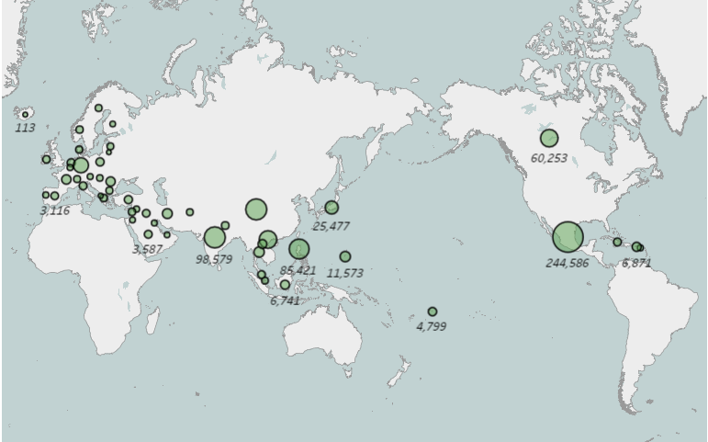
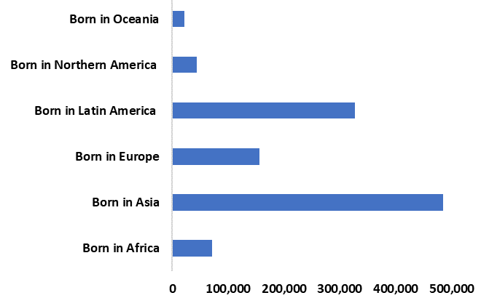
Washington’s Immigrant Population
About one in seven Washington residents is an immigrant, while another one in seven residents is a native-born U.S. citizen with at least one immigrant parent.
Nearly half (48%) of Washington’s immigrant population was born in the continent of Asia.
22.9% of all immigrants were born in Mexico.
80,910
68,267
27,709

Slide 7
Immigrant Contributions to Washington State
Occupation Category | Number of Immigrant Workers
Computer and Mathematical | 70,152
Management | 67,992
Transportation and Material Moving | 66,861
Office and Administrative Support | 58,281
Sales and Related | 55,440
Source: Analysis of the U.S. Census Bureau’s 2018 American Community Survey 1-year PUMS data by the American Immigration Council.
Immigrant-led households in the state paid $3.9 billion in state and local taxes and had $34.3 billion in spending power (after-tax income) in 2018.
80,984 immigrant business owners accounted for 19 percent of all self-employed Washington residents in 2018 and generated $2.3 billion in business income.
About one in five workers in Washington is an immigrant, together making up a vital part of the state’s labor force in a range of industries.
Occupations with the highest percentage of immigrants are some of the most in demand occupations in state government
Industry | Number of Immigrant Workers
Health Care and Social Assistance | 102,277
Professional, Scientific, and Technical Services | 90,712
Retail Trade | 83,975
Manufacturing | 74,952
Accommodation and Food Services | 65,721
Source: Analysis of the U.S. Census Bureau’s 2018 American Community Survey 1-year PUMS data by the American Immigration Council.

Slide 8
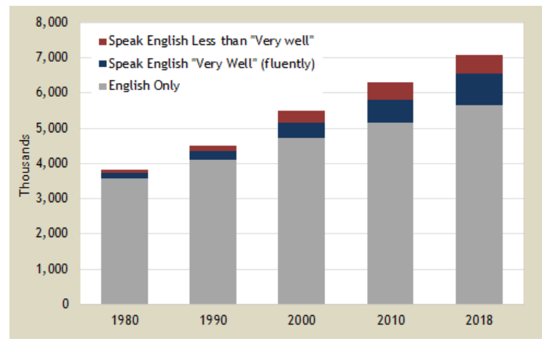
Washington’s LEP Population
According to 2016 estimates, there are 38 languages that have more 1,000 persons who have limited English proficiency.
The percentage of persons living in households that speak English less than “very well” has been growing.
Just over 68% of all LEP persons speak primarily Spanish.

Slide 9
Benefits of Hiring Immigrants
Immigrants are survivors
Immigrants are grateful/hard workers
Immigrants foster diversity/ culture/great learning
Immigrants are risk takers
Supports/Resources
Language Assistance
Advancement training
Communication
FAQ

Slide 10
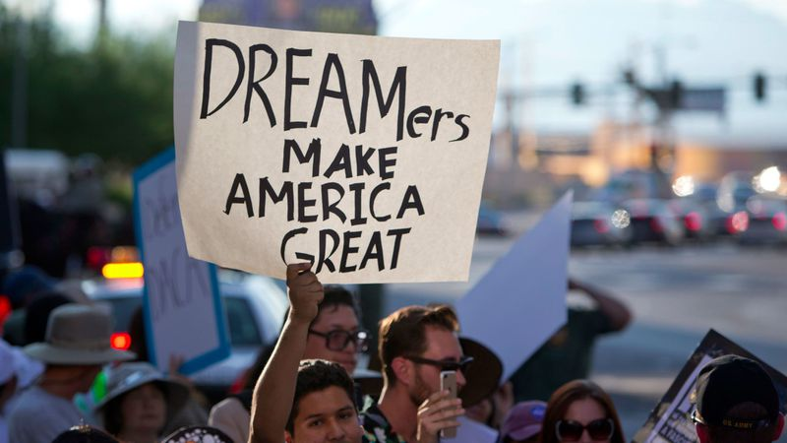
Immigrants are:
Survivors
Journeys of adversity marked by perseverance and success
An attitude of survival creates a culture of resourcefulness
Grateful
Extremely hard working
Recognize the gift of opportunity
Diligent, early, going the extra mile

Slide 11

Immigrants are:
Empowering workplace culture
Foster a new sense of learning and innovation
Vitalize and enrich a diverse workplace
Diverse organizations benefit from a multitude of perspectives
Risk-takers
Courageous
Spirit of creativity, willingness, and risk. Fail fast, recover faster. Falling forward for success

Slide 12
4 Avenues of Success
Language
  We must re-frame the discussion regarding perceived language barriers.
  Learn the work-related vocabulary of immigrants we hire to demonstrate our support and encourage them to succeed.
Advancement
  Provide job-related training opportunities.
  We must create paths of success.
Communication
  Increased written documentation to prevent misunderstandings.
  Review information in-person
FAQ
  WIN working on FAQ to offer resources to immigrants in our workplaces

Slide 13

Expanding Employment Opportunity /Career Path through Mentorship Program
WIN’s mentoring program is open to all WIN’s members. There is no previous membership length requirement.
Mentorship benefits:
Valuable knowledge from the mentor’s expertise
Increase competencies in specific areas
Focus on career interests and career path
Make a personal connection and build relationships
Broaden understanding of other agencies and/or across
the state enterprise.
Networking opportunities
Mentor’s time commitment
We recommend approximately 2-4 hours of work time per month

Slide 14

Quarterly Informal Networking-Social Hour
Zoom, Thursday, 1/28/2021 4:30 PM-6:00 PM
Meet our Hosts:
Lolo Arevalo, Workforce Diversity & Recruitment Manager at Department of Corrections
Anu Rao, Business Manager/ HR Talent Acquisition at DSHS
For Zoom details, please contact us: WIN@ofm.wa.gov

Slide 15
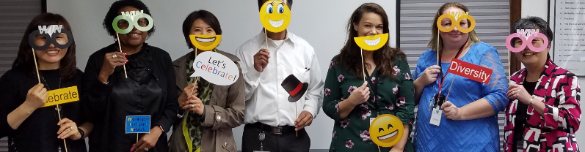
Meet WIN’s Members
Any questions or comments?
Please visit us at www.washingtonimmigrantnetwork.org/
WIN@OFM.WA.GOV
We meet first Tuesday of the month from 12-1 pm. Hope to see you there!

